Slide 1
OLSS Unit Testing
09 March 2021

Slide 2
Flow Process
Create unit testing using VS Test
Create Pipeline
Execute
Report
Apps:
Visual Studio 2013 Pro
Azure Devops

Slide 3
Create Unit Testing

Slide 4
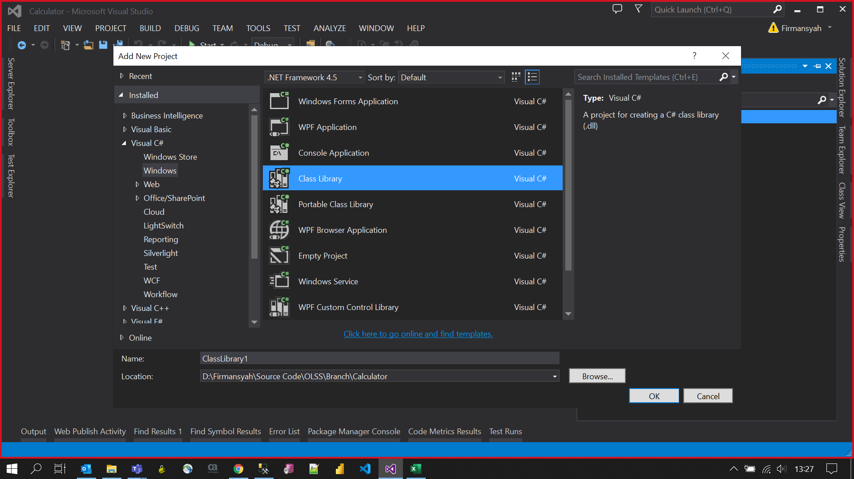
Add new Project

Slide 5
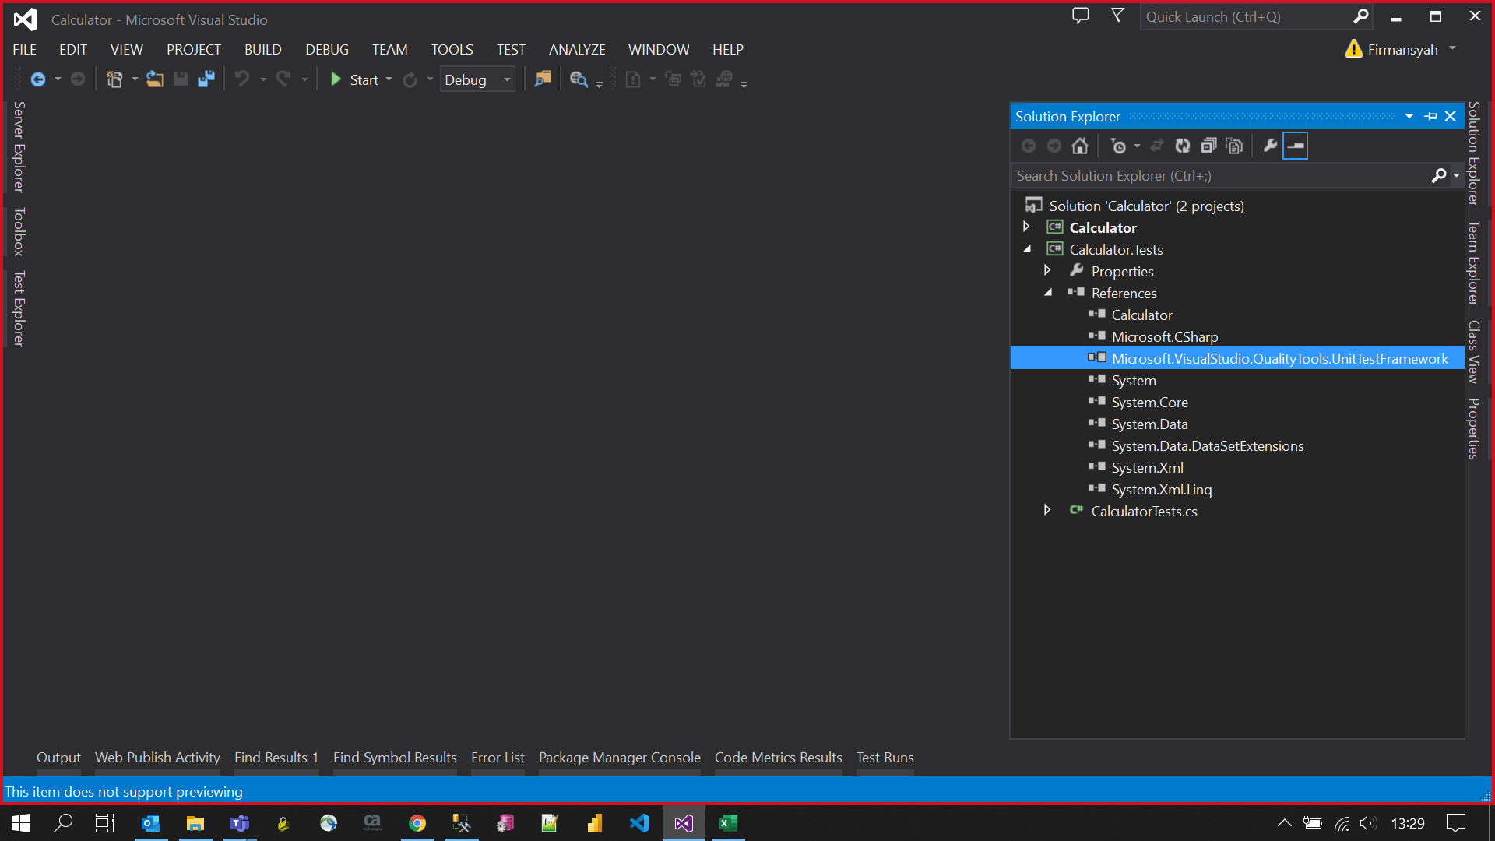
Add references

Slide 6
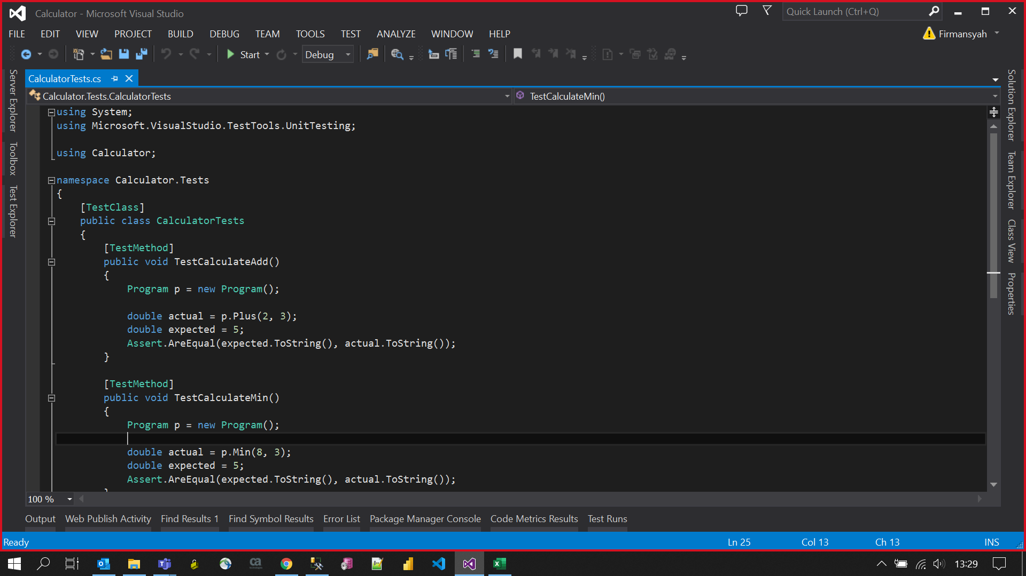
Create Unit Test

Slide 7
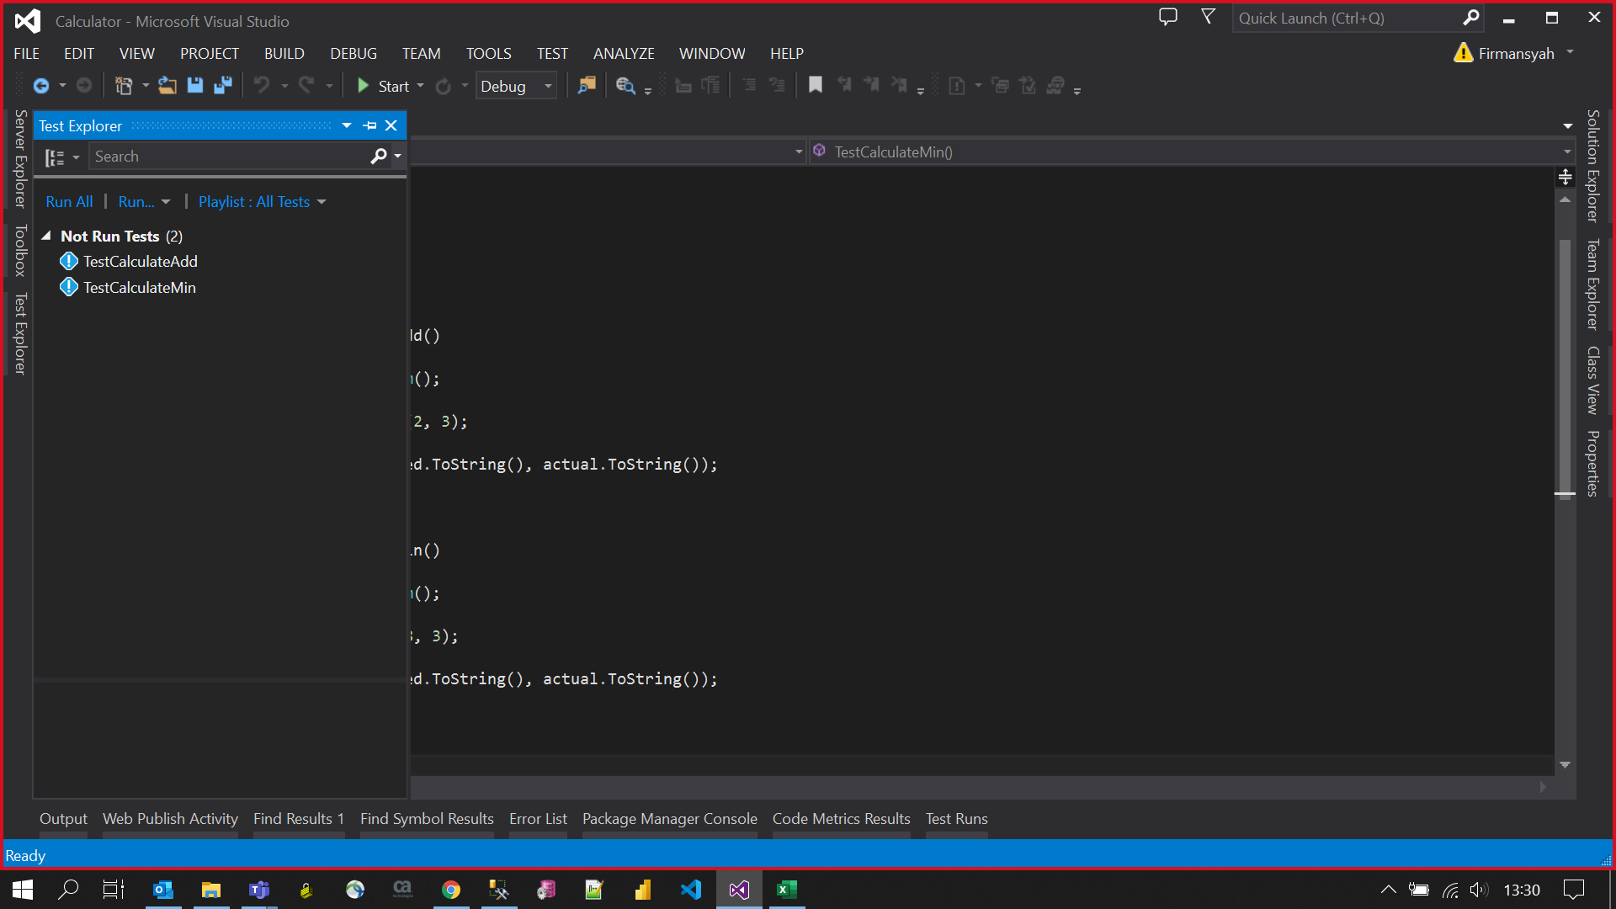
List Test

Slide 8
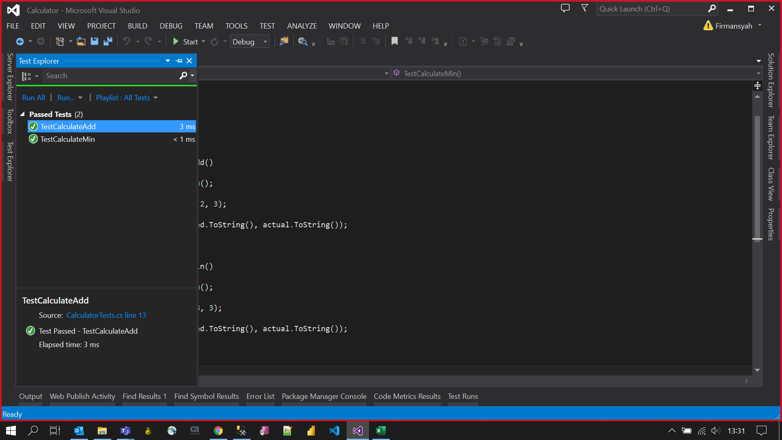
Running in local environment

Slide 9
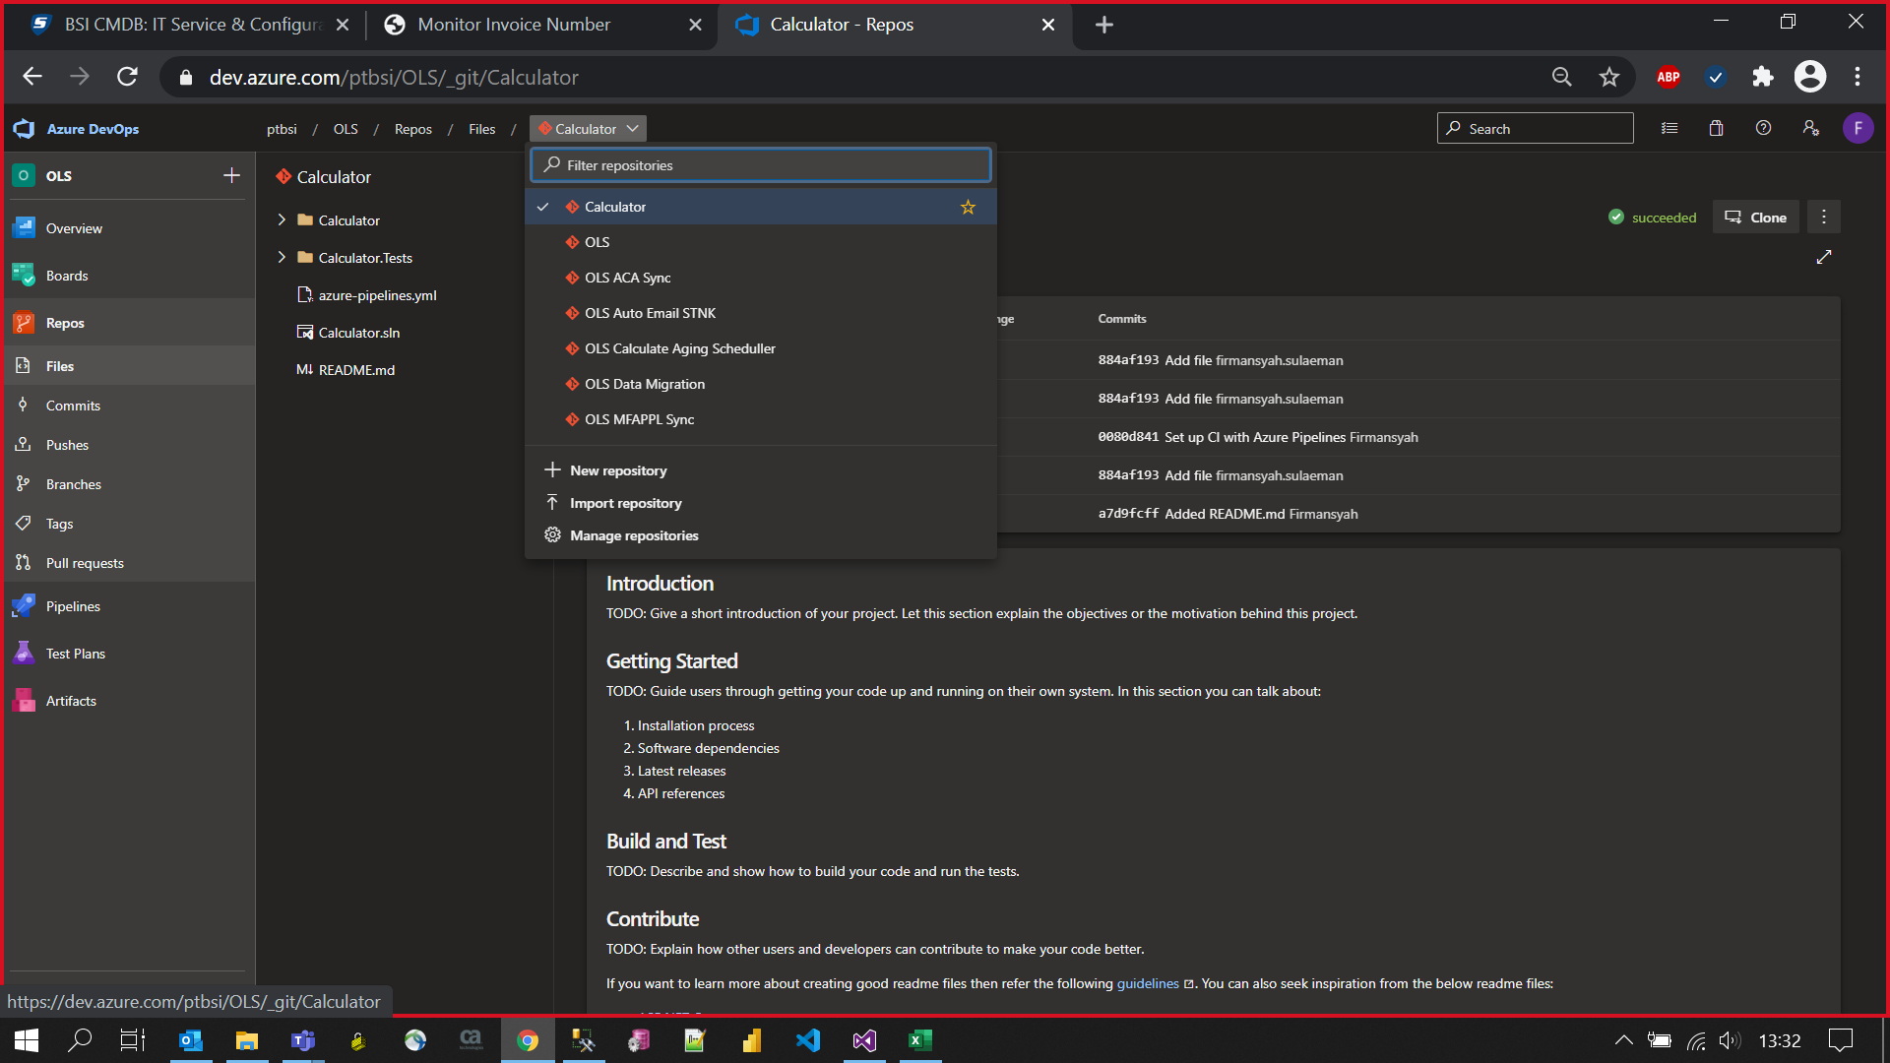
Azure Repo (After Commit)

Slide 10
Create New Pipeline

Slide 11
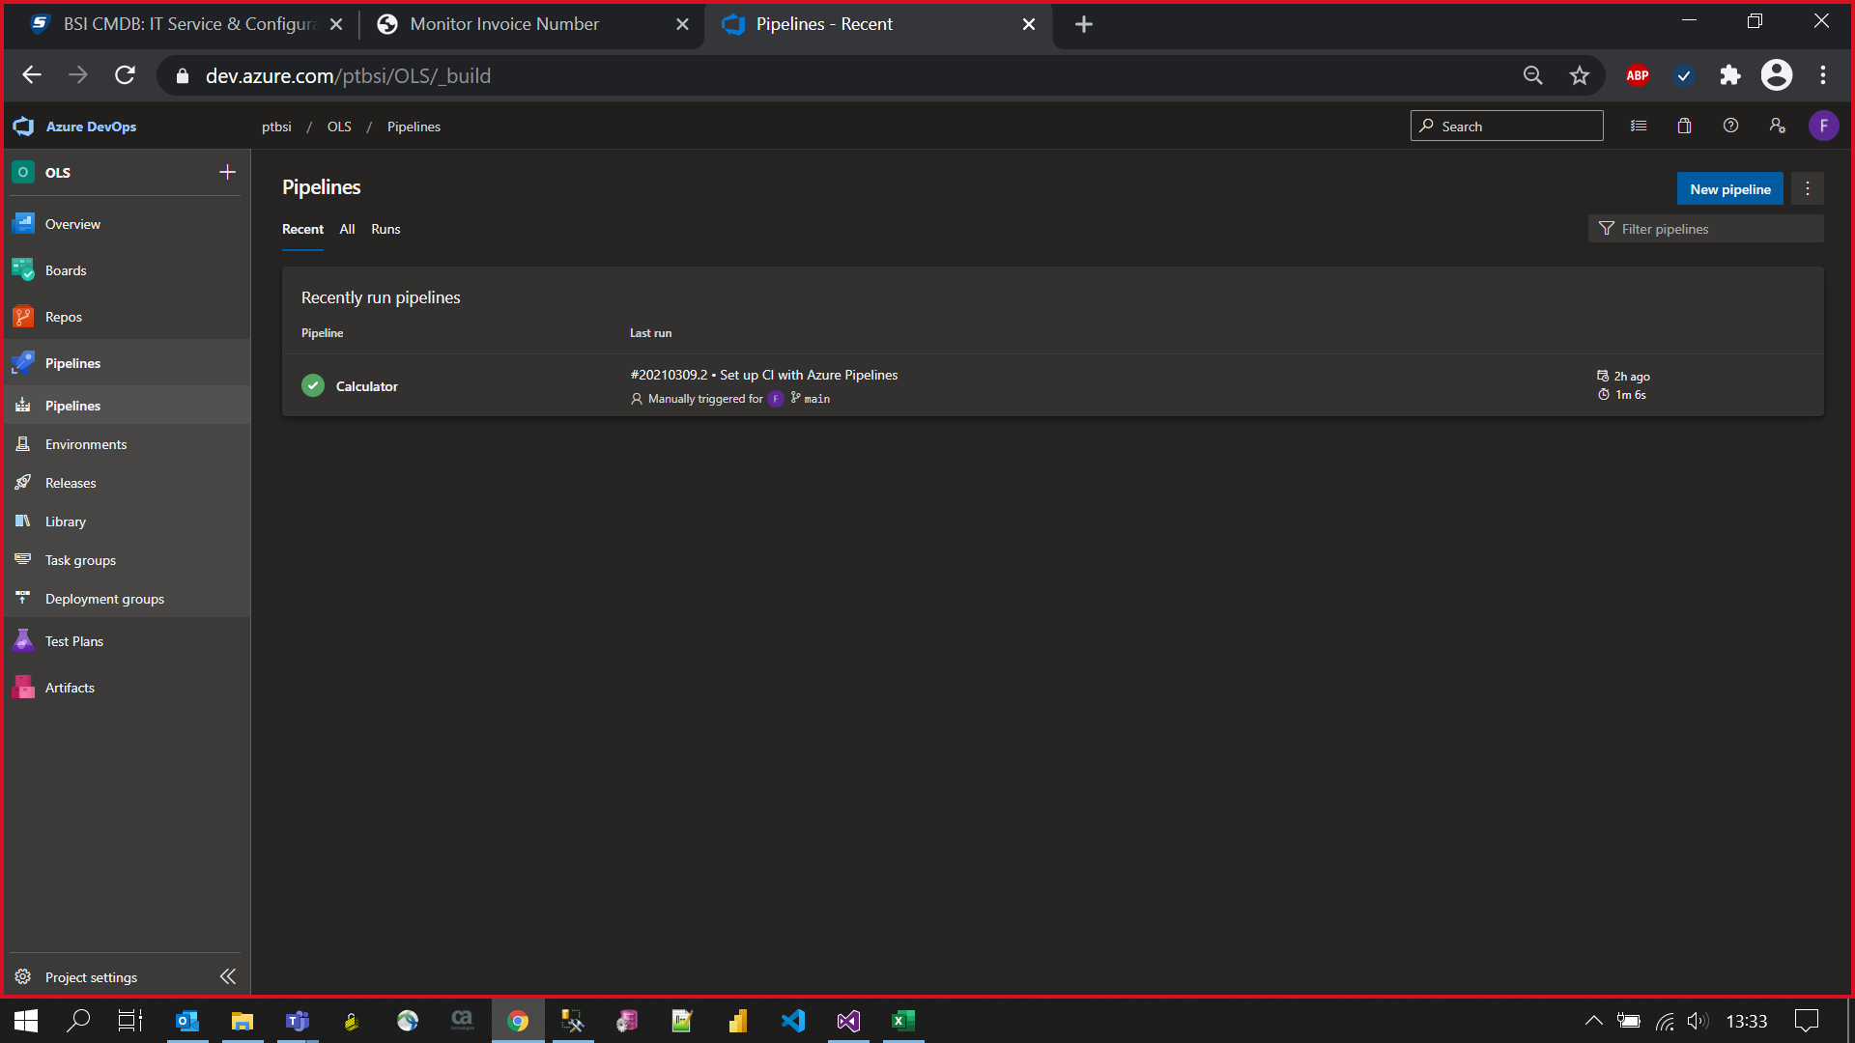
Create New Pipeline

Slide 12
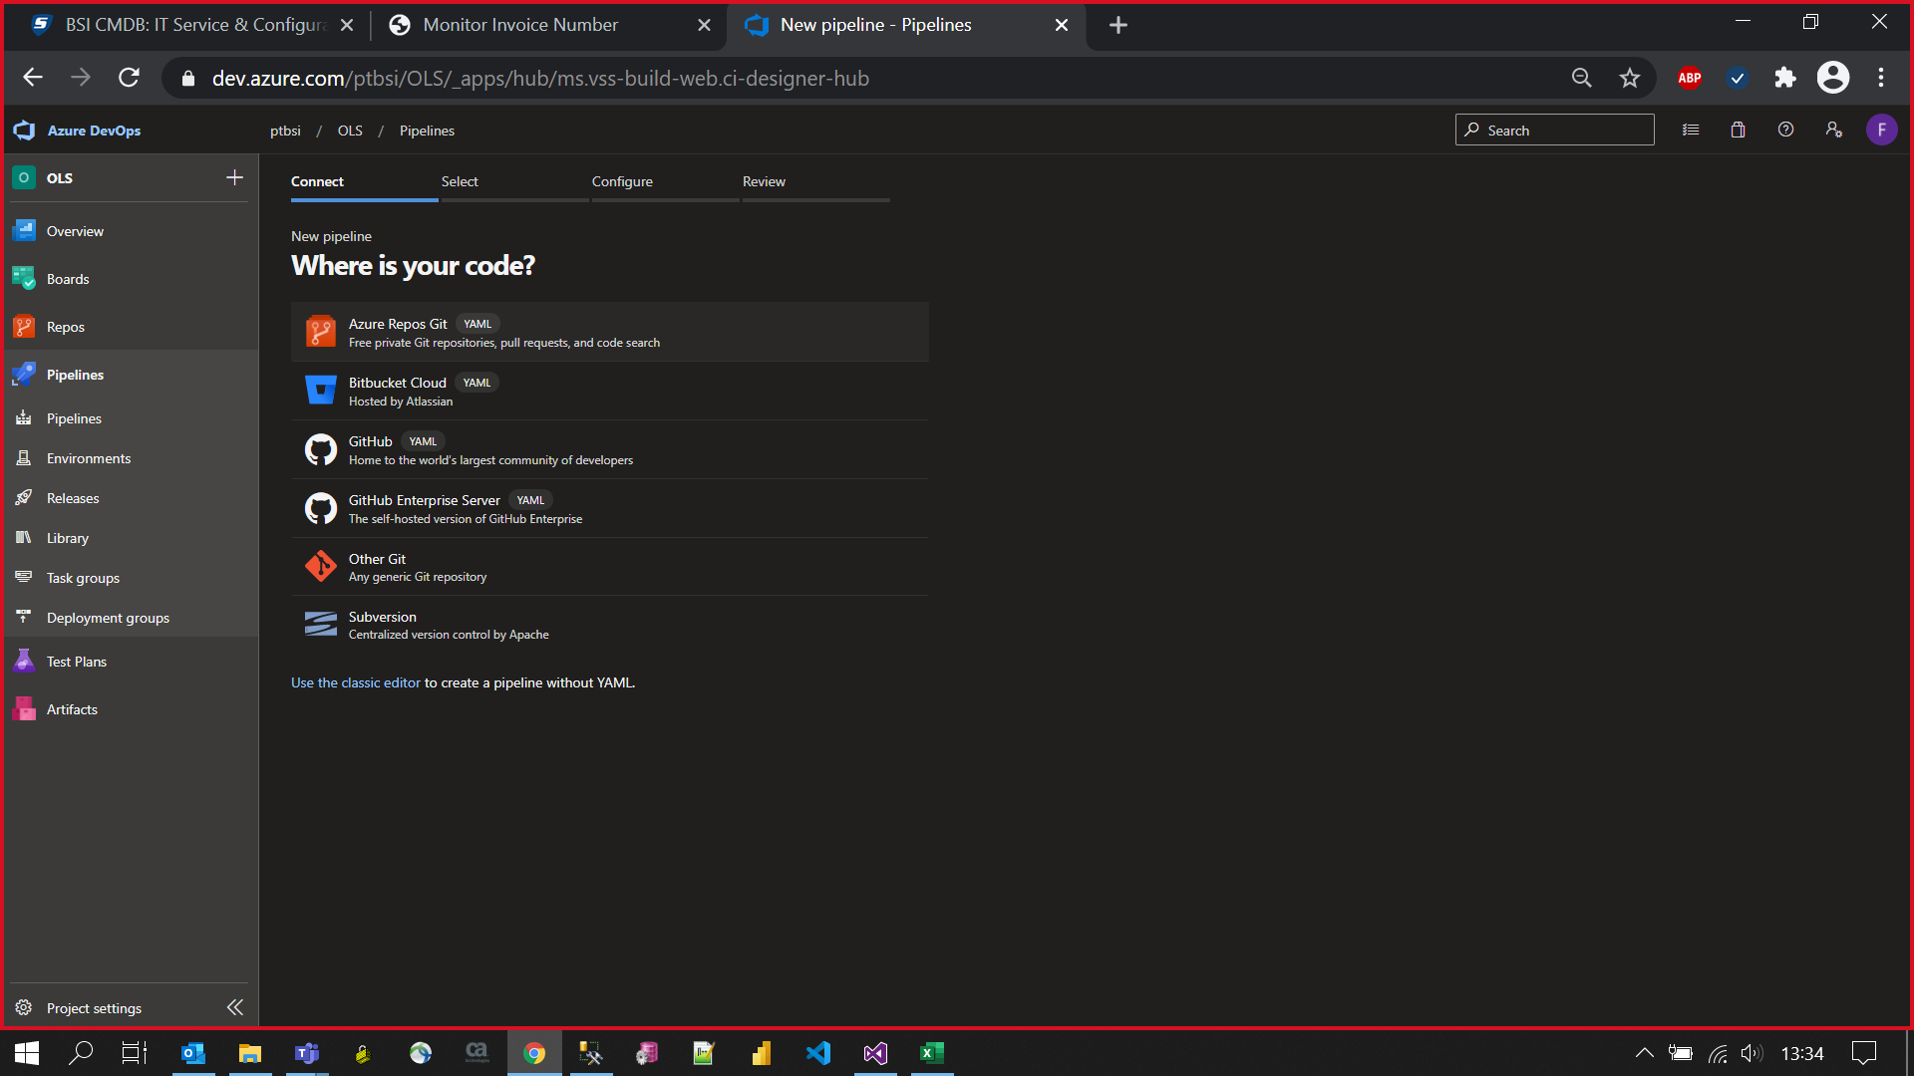
Azure Repos Git

Slide 13
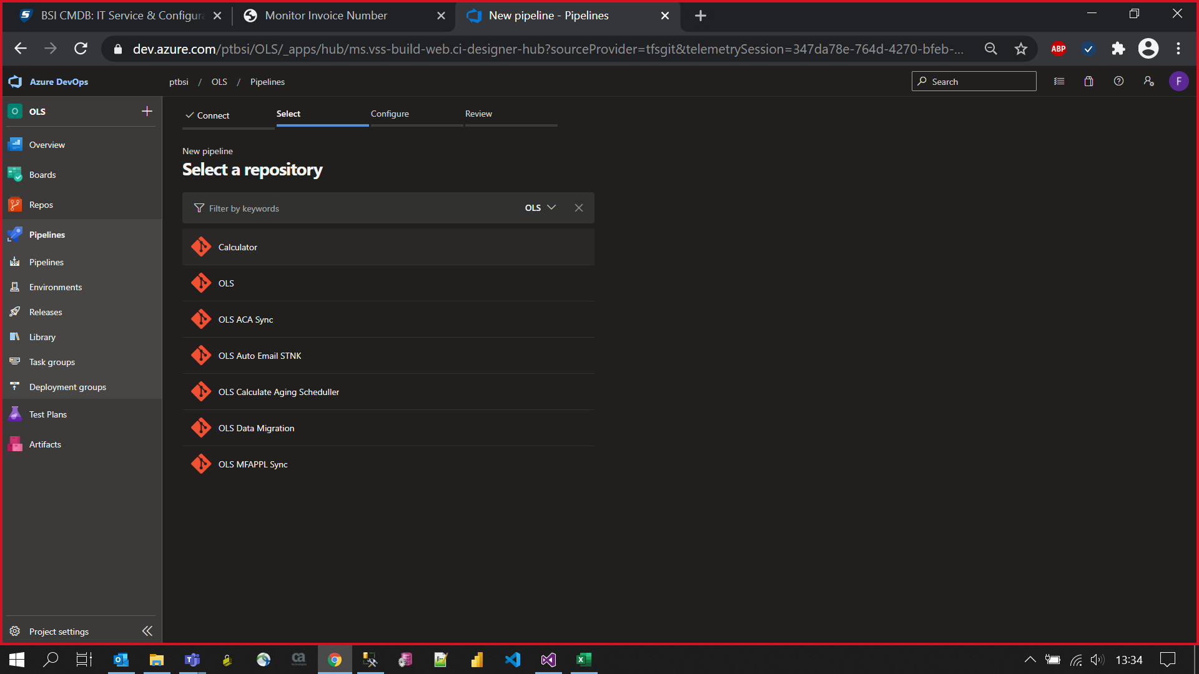
Select Repo for Testing

Slide 14
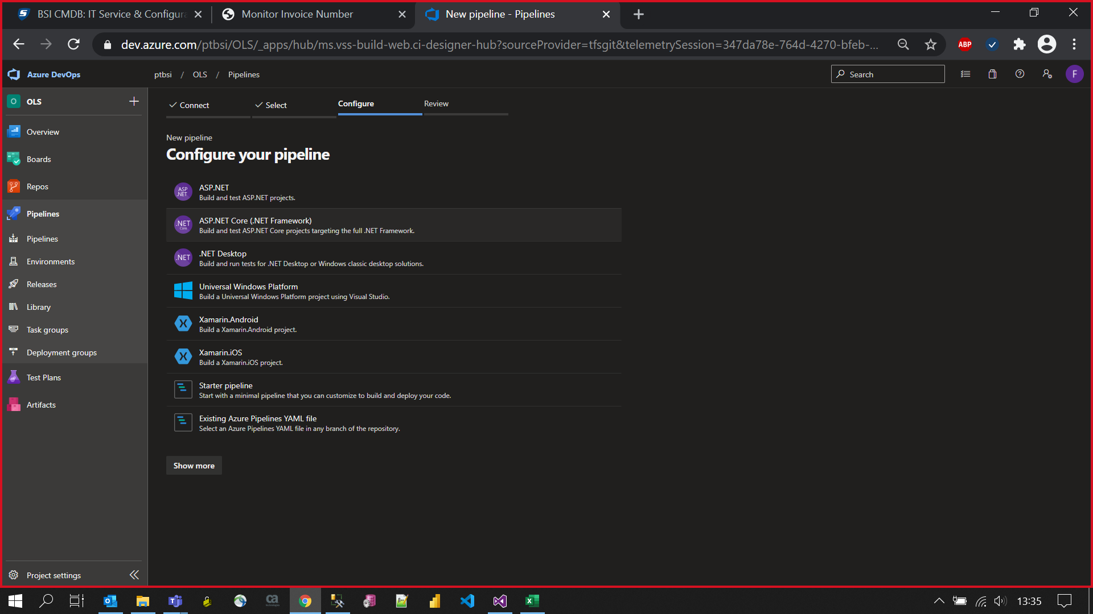
Choose ASP.Net Core

Slide 15
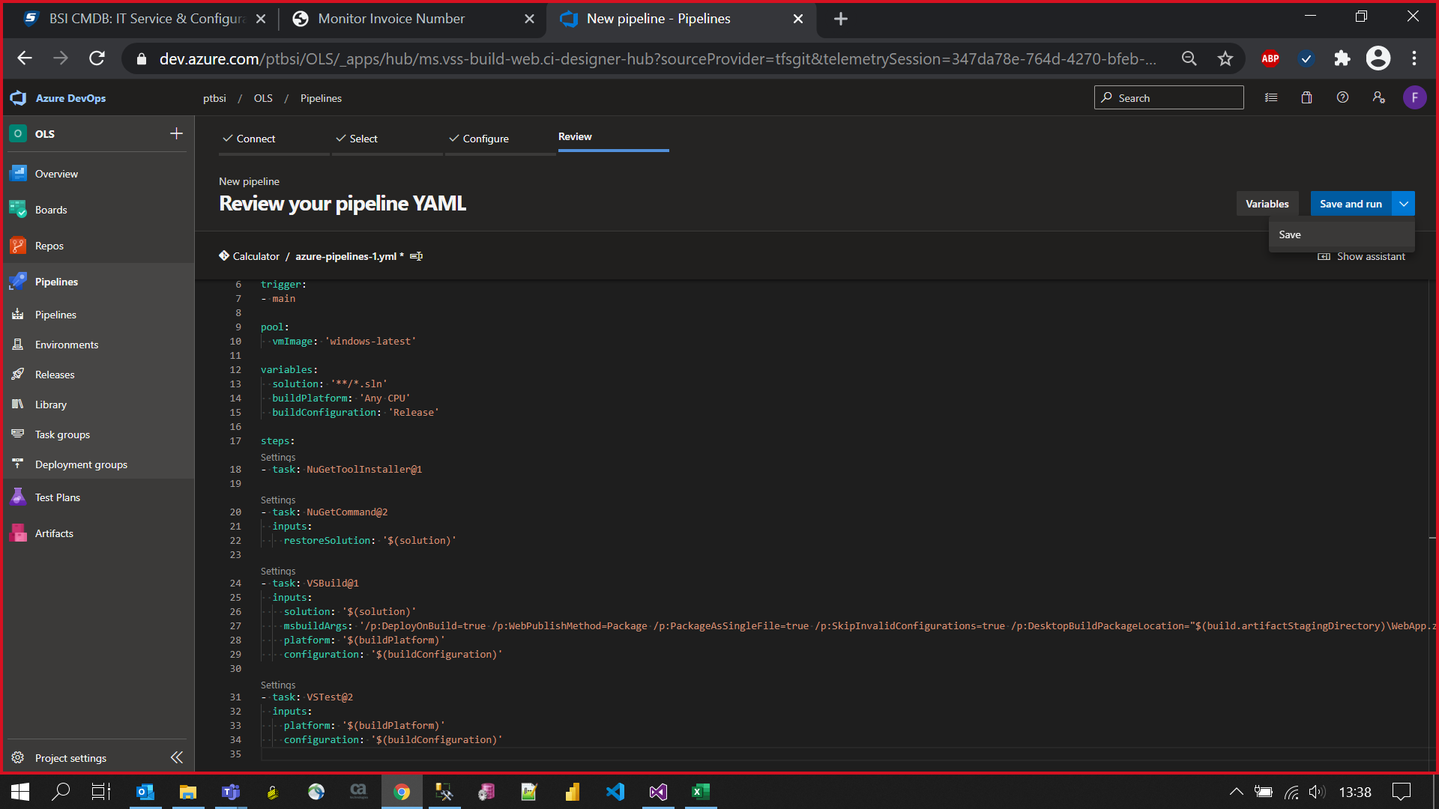
Save & Run Pipeline

Slide 16
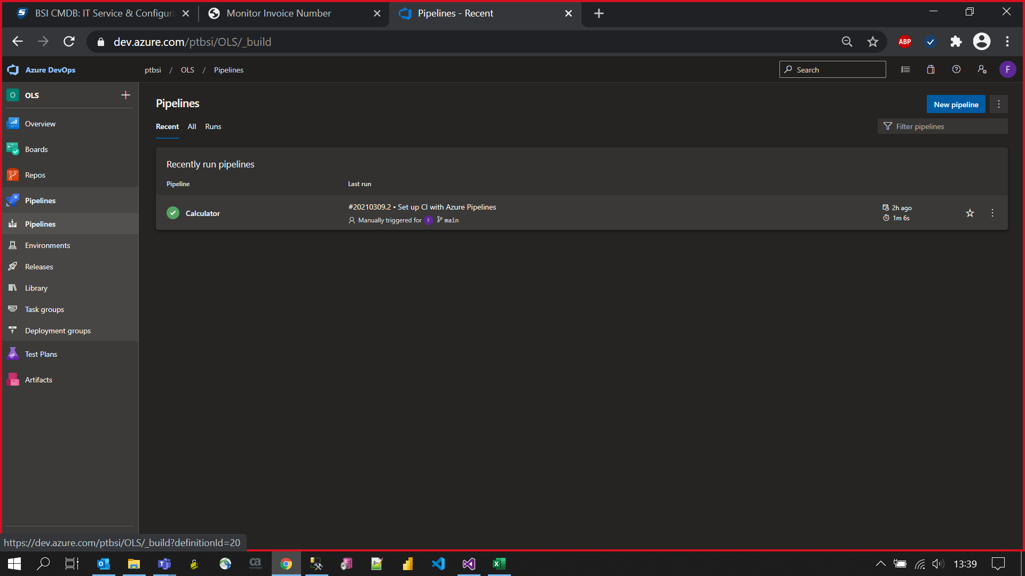
Pipeline Result

Slide 17
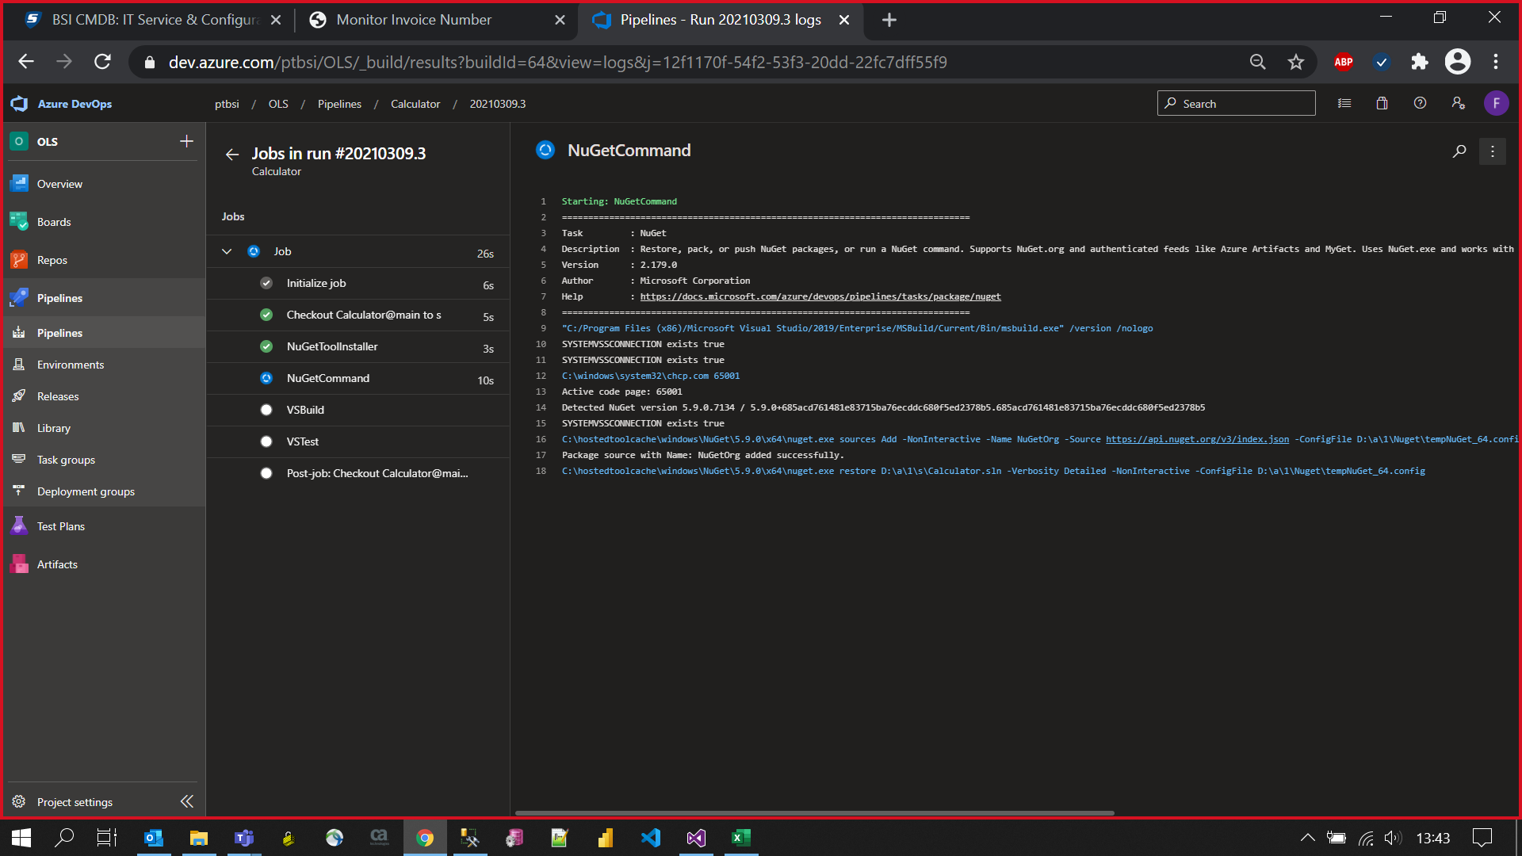
Log

Slide 18
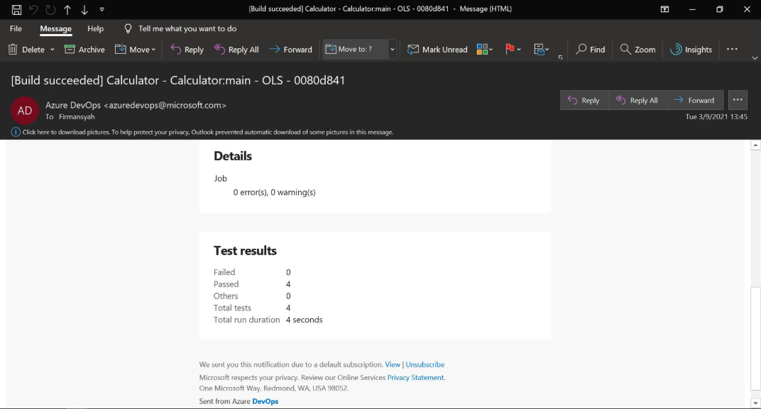
Success Result

Slide 19
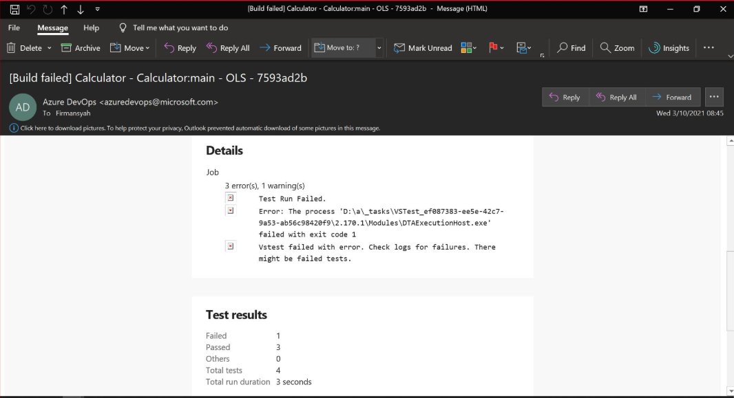
Failed Result

Slide 20
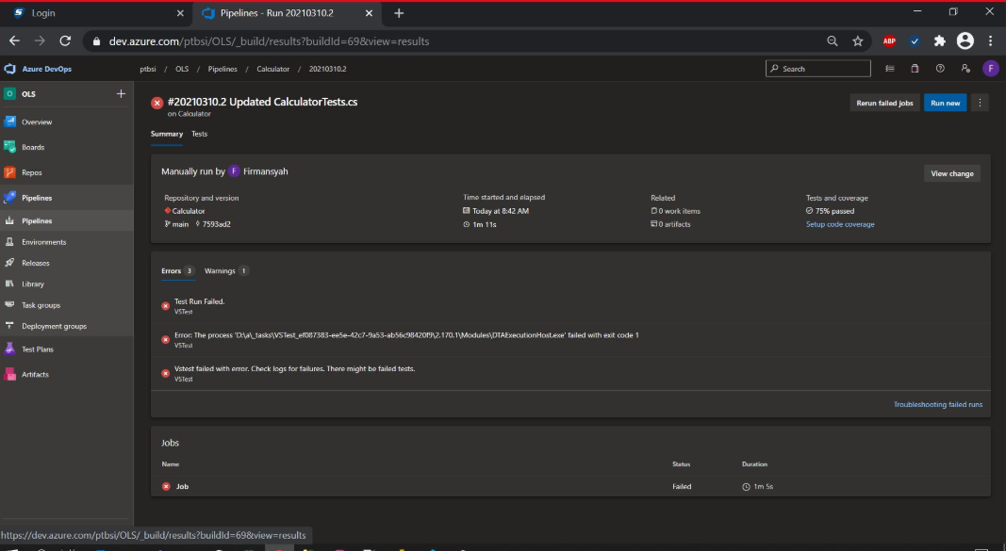
Failed Summary

Slide 21
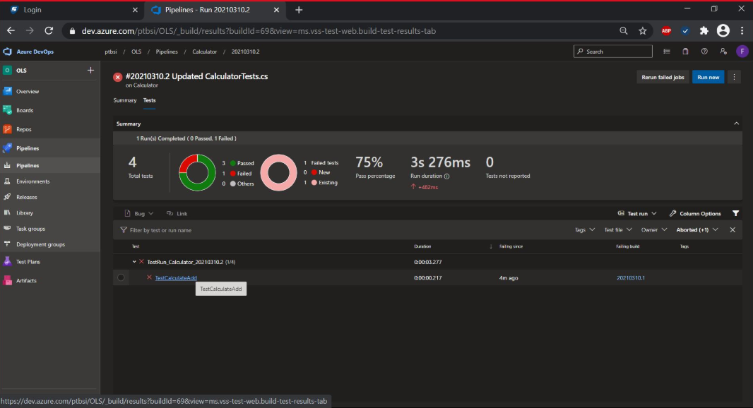
Result Summary

Slide 22
Thank you

